Slide 1


Slide 2

Science Fair
Year 7-10 students will celebrate National Science Week by participating in SRC’s Science Fair

Slide 3
How does it work?
Working in groups, you’ll have one Science class each fortnight to plan and conduct an open investigation on a topic of your choice!
You’ll present your work on a poster (along with any props) at the Science Fair in Term 3 Week 5
Your work will be judged - there will be prizes for the best investigations
The most creative and unique investigations will also be submitted to STAWA Science Talent Search competition – cash prizes!
Notes:
Science Week 10-18 August
STAWA Entry submission 5-23 August

Slide 4
This means YOU get to choose what to investigate instead of your teacher telling you what to do
Try and choose a topic that is:
Important to you
Important to others
Creative
Interesting to you

Slide 5
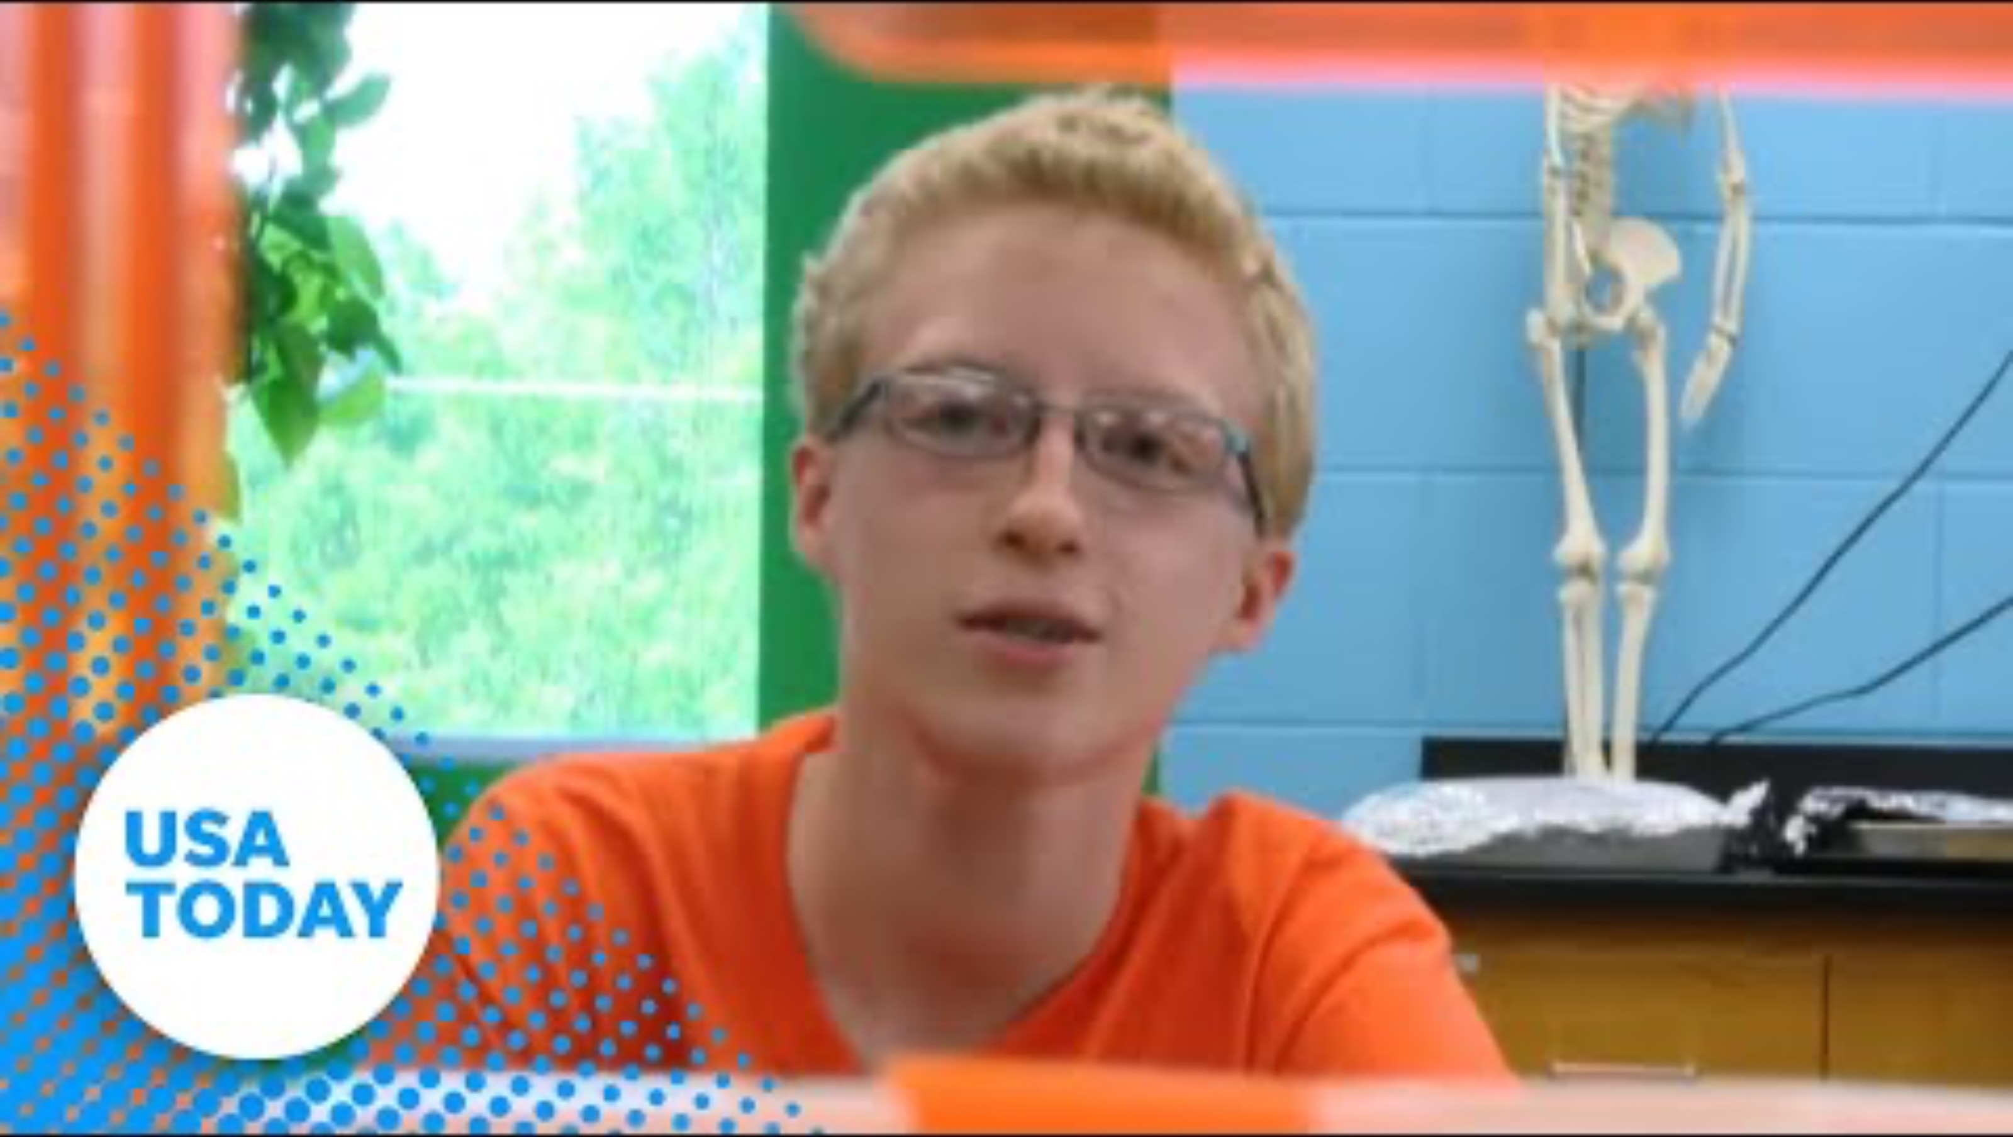
Students have made some pretty big discoveries by participating in Science Fair:
Notes:
More Science fair inspiration:
https://www.youtube.com/watch?v=UOdC8ivTuhk&ab_channel=Seeker
https://www.youtube.com/watch?v=MtOYYwqAoak&ab_channel=ABCNews
https://www.businessinsider.com/awesome-science-fair-projects-by-teenagers-2013-6#eesha-khare-developed-supercapacitor-technology-that-in-the-future-could-charge-a-battery-fast-3

Slide 6

Assessment
You will be assessed on your investigation:
Poster (group mark)
Short validation test (individual mark)

Slide 7
Timeline
WEEK 1:
Choose group
Start thinking about a suitable topic or choose from the above list
Brainstorm by getting as many ideas as you can as quick as you can
Ideas that are ridiculous today might be brilliant tomorrow
WEEK 2:
Narrow possibilities and choose your topic
Discuss it with your teacher
Do some background research on the topic
Complete the planning stage using the Investigation Planning Sheet
WEEK 3:
Prepare list of equipment – your teacher will be able to organise general science equipment, but you will have to organise/purchase specialised equipment yourself

Slide 8
Timeline
WEEK 4:
Complete preliminary trials. Refine plans and equipment needs
Begin observations and measurement
Begin writing the early sections of your report
WEEK 5:
Continue the investigation
Complete data collection and analysis
Continue writing your report
WEEK 6:
Complete the write-up
Work on your Science Fair poster

Slide 9
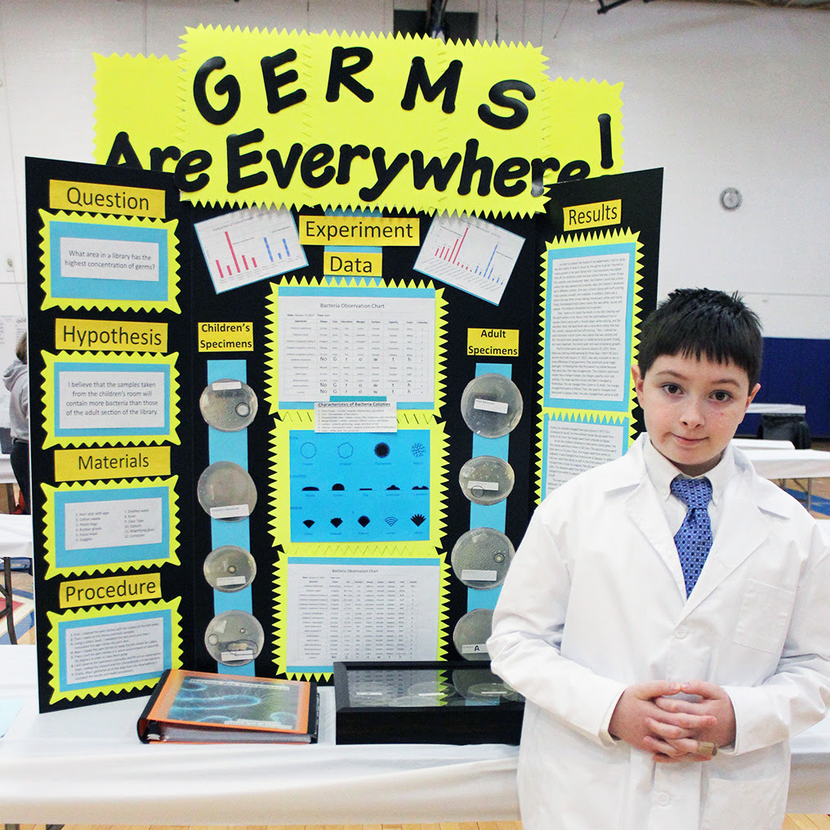
Inspiration

Slide 10
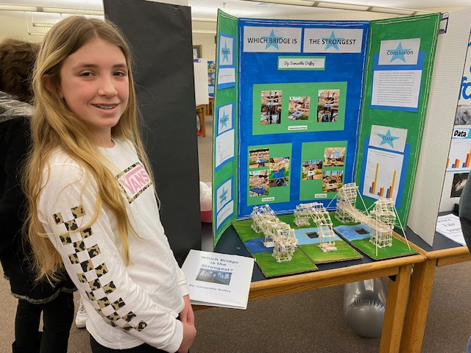
Inspiration

Slide 11
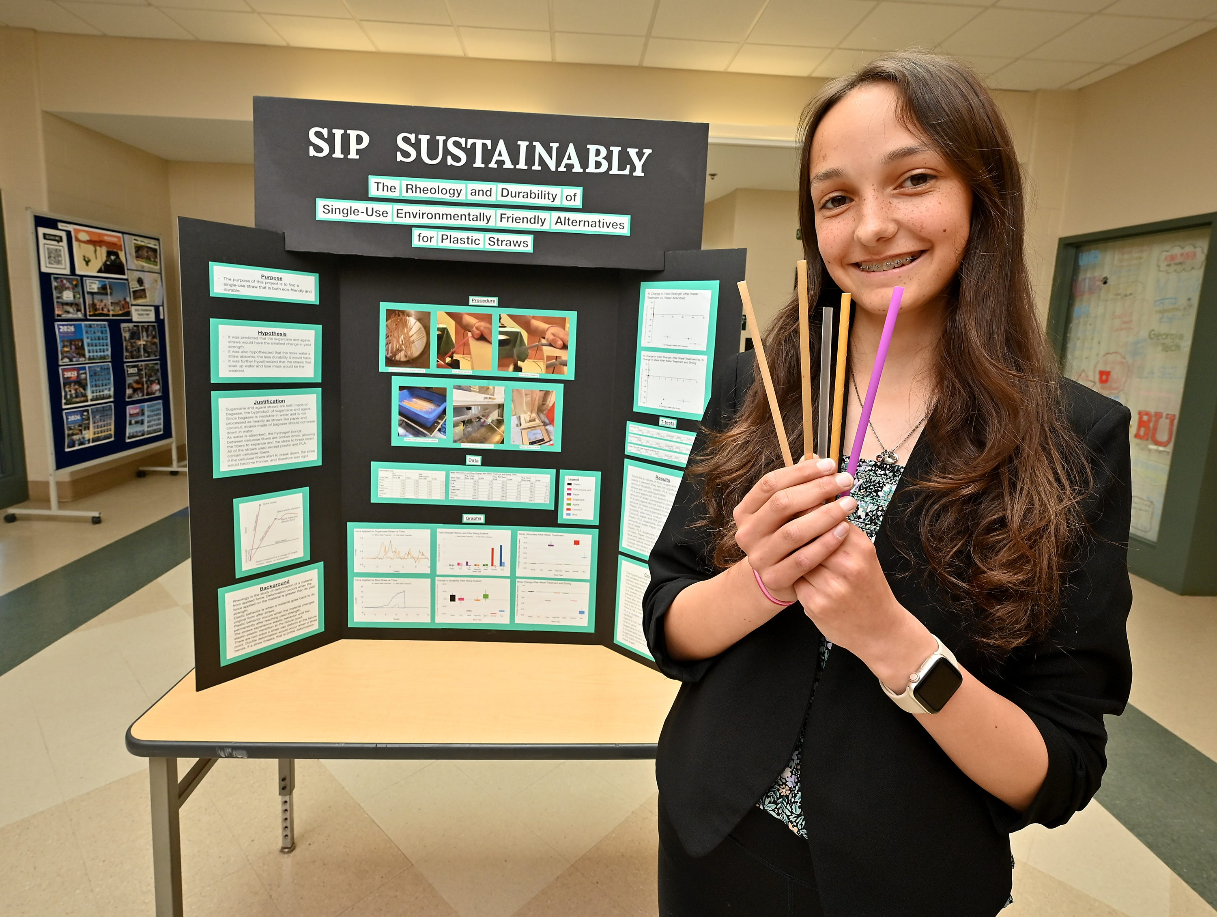
Inspiration

Slide 12
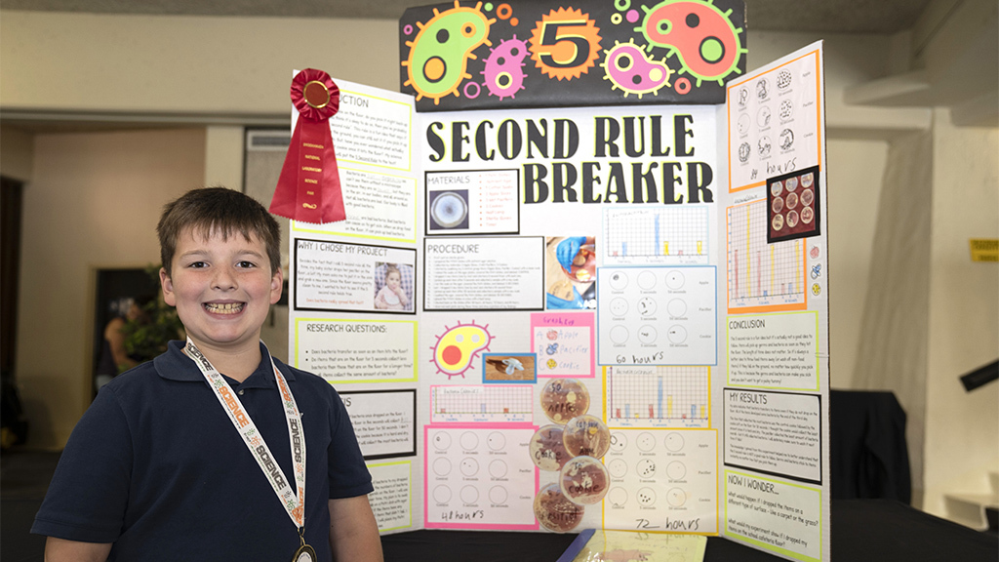
Inspiration

Slide 13

Inspiration

